Slide 1
Developing and testing the Dynamic Habitat Index from Terra and Aqua MODIS Data for biodiversity and conservation science
Volker C. Radeloff, University of Wisconsin-Madison
N. Suttidate, B. Borisov, T. Brooks, M. Clayton, N. Coops, C. Graham, T. Ives, T. Kuemmerle, A. Pidgeon, C. Rondinini

Slide 2
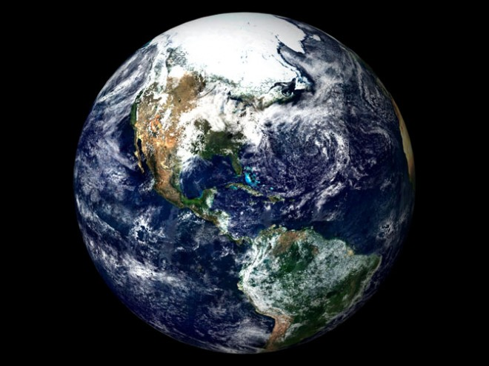

Slide 3
SAVI
SPOT Vegetation
MODIS
LAI
EVI
AVHRR
fPAR
NPP
NDVI

Slide 5
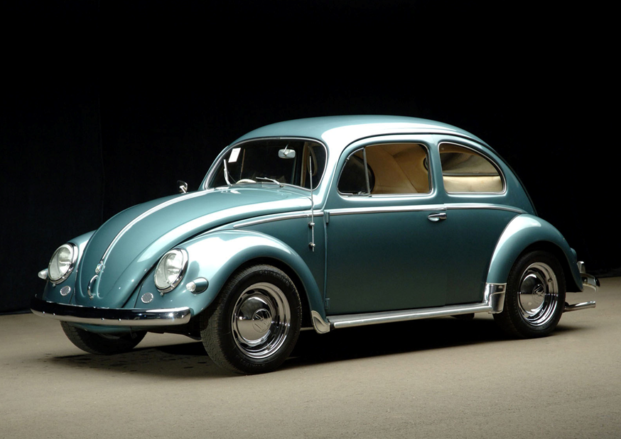

Slide 6
NDVI

Slide 7
Need: A standardized measure of productivity for biodiversity science and conservation

Slide 8
Dynamic Habitat Index

Slide 9
Dynamic Habitat Index

Slide 10
Dynamic Habitat Indices

Slide 11
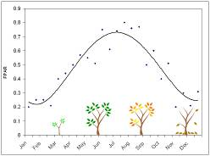
DHI
Cumulative productivity
Minimum productivity
Seasonality (CV of productivity)

Slide 12
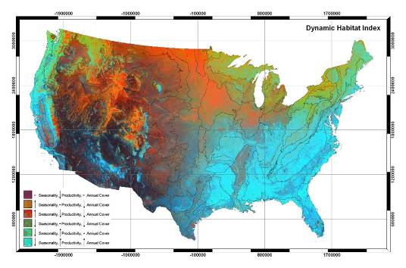
RGB: Seasonality, Cumulative, Minimum

Slide 13
Case studies

Slide 14
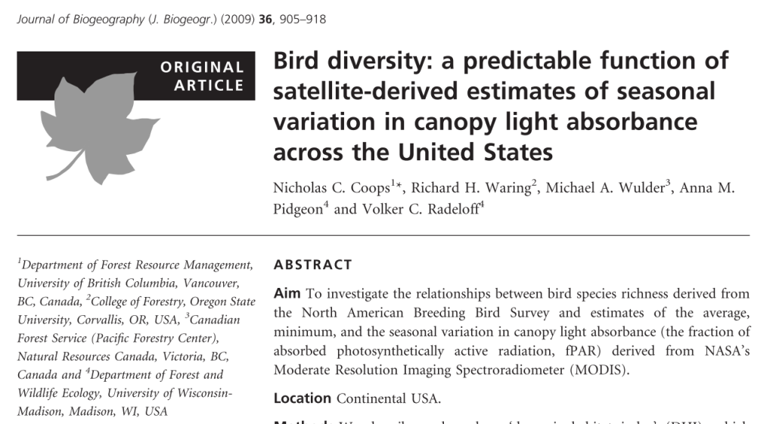
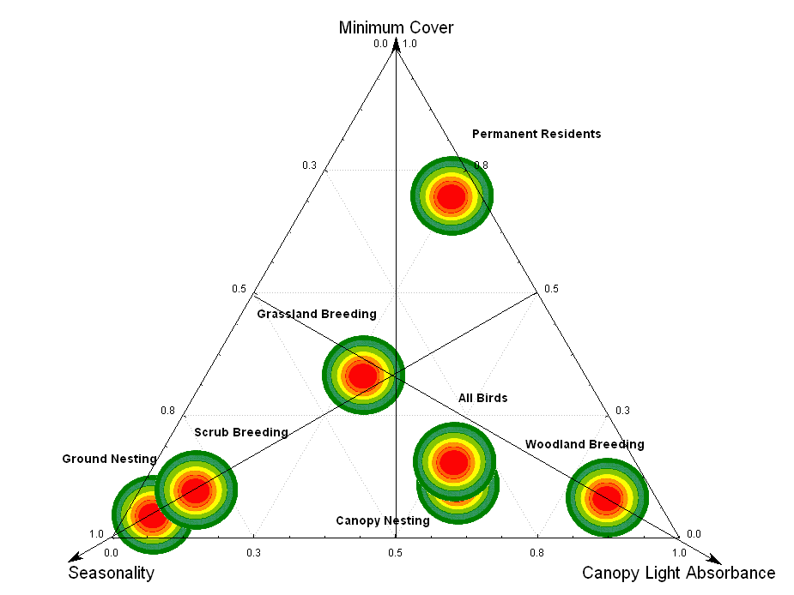
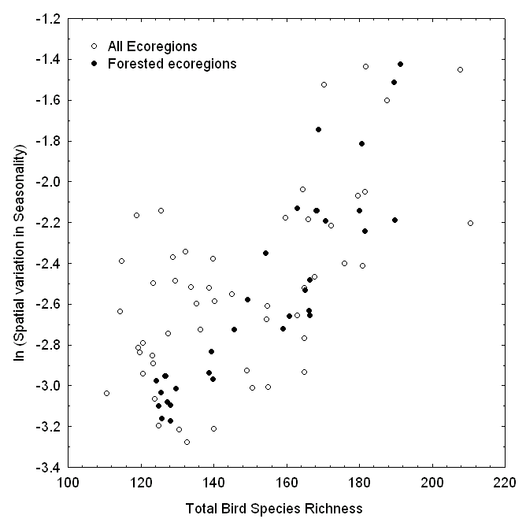

Slide 15
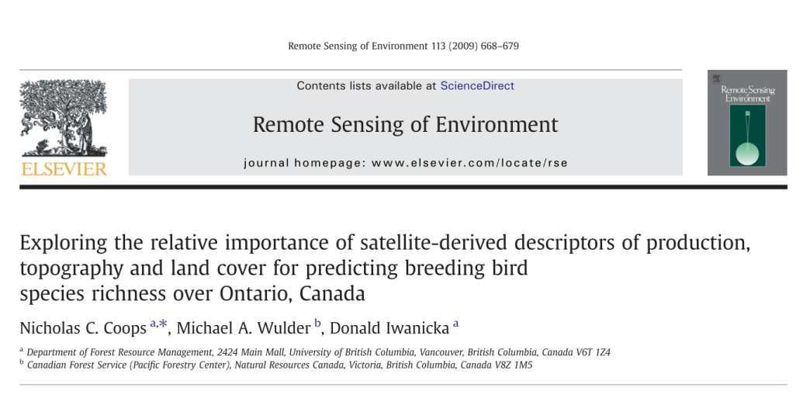
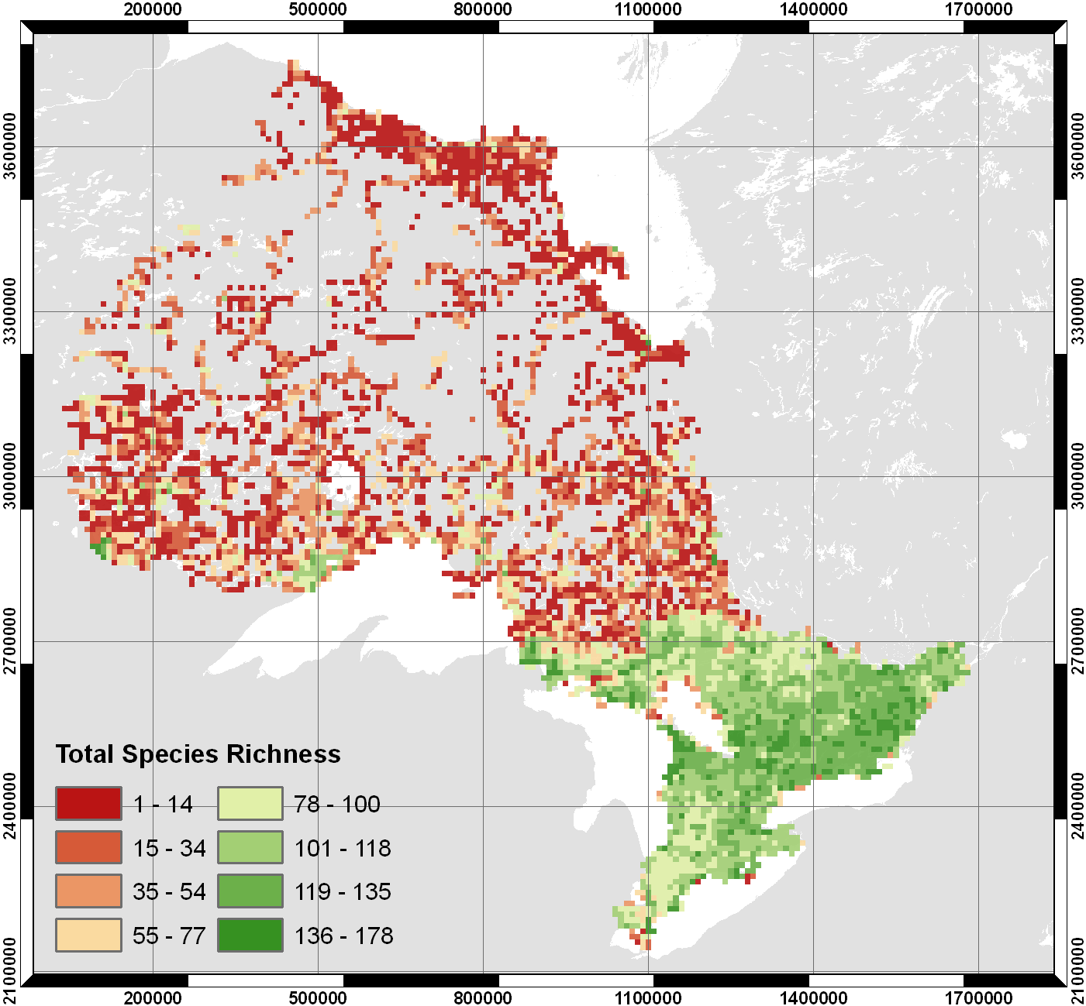
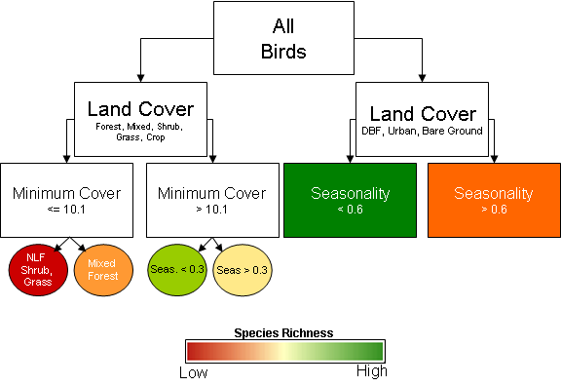
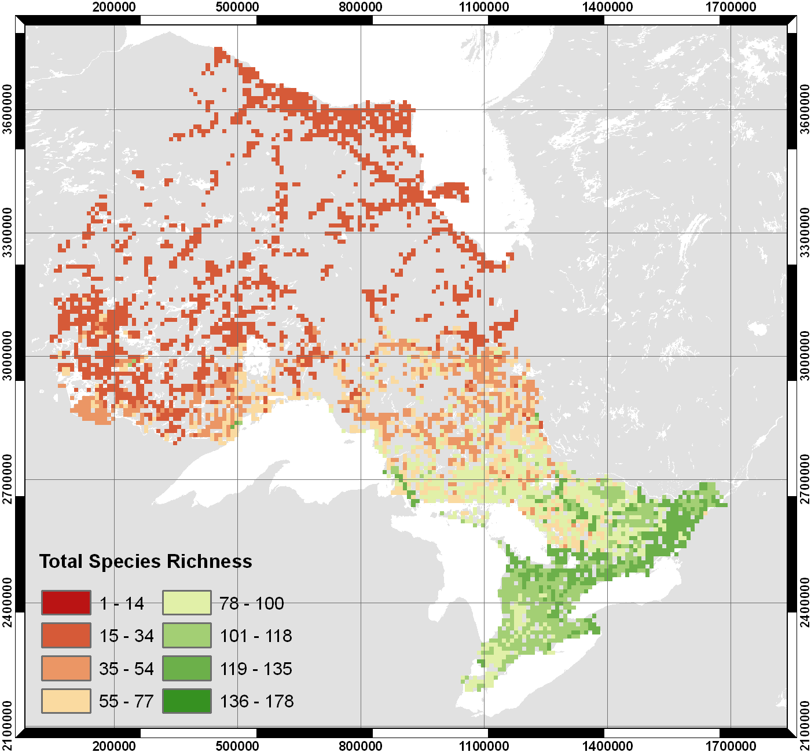
Observed
Predicted

Slide 16
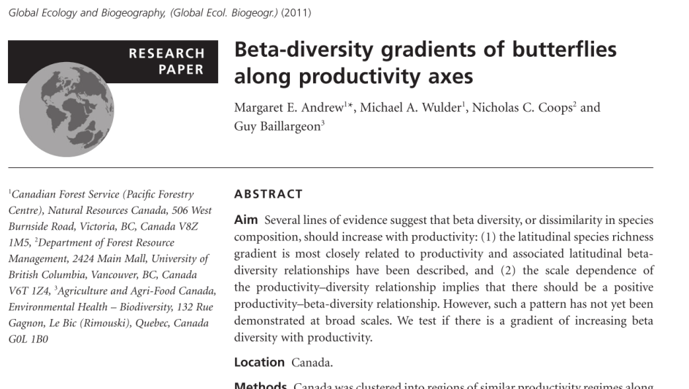
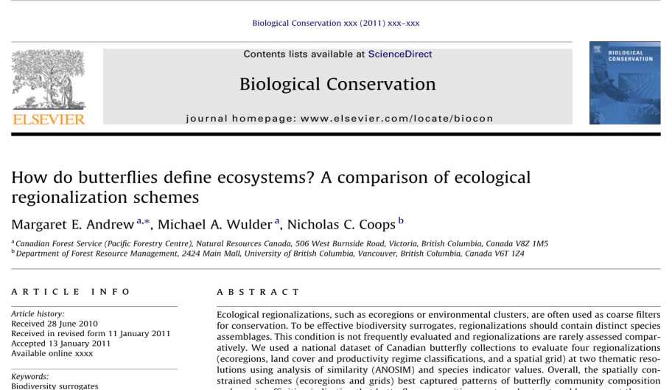

Slide 17
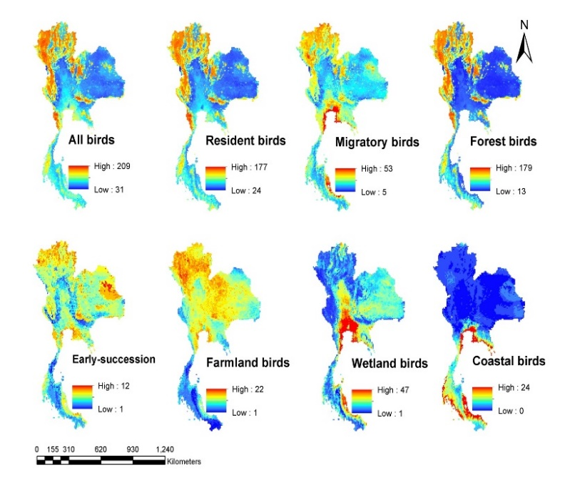
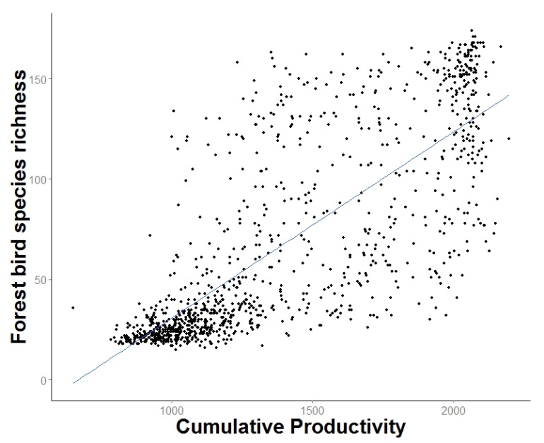
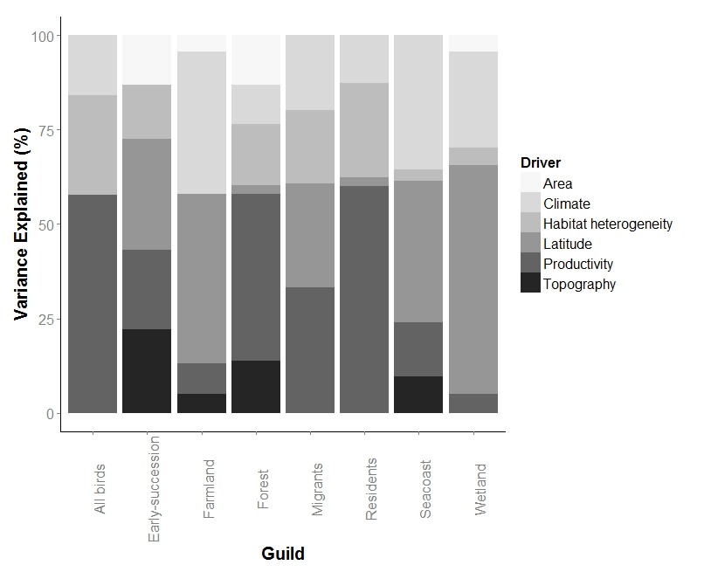
Suttidate et al., in prep

Slide 18
Global DHI

Slide 19
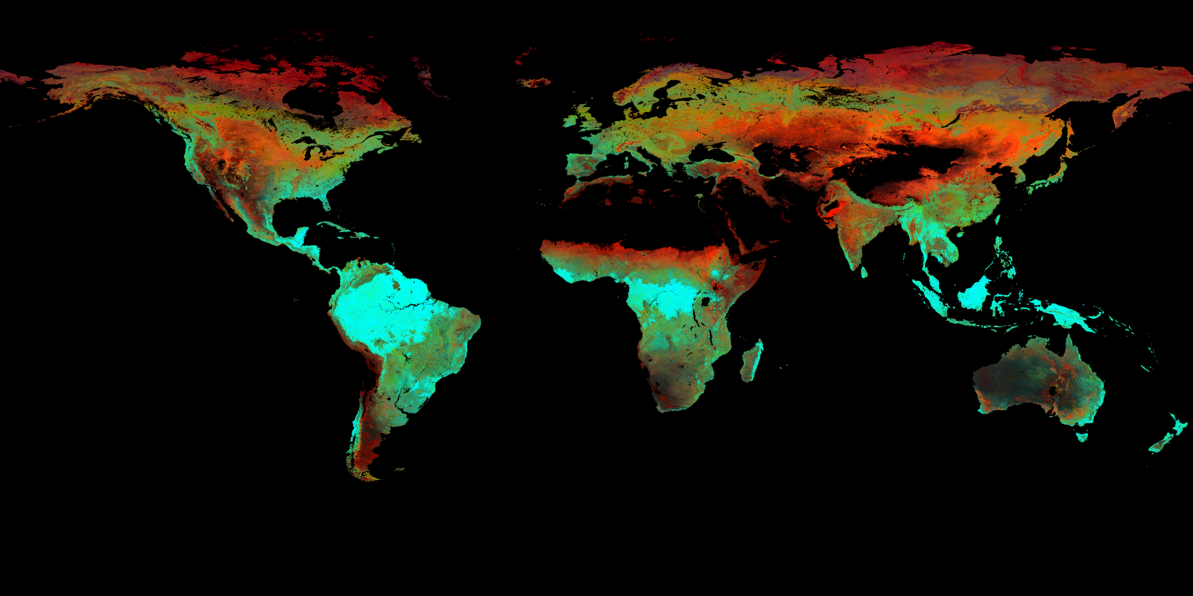
2010

Slide 20
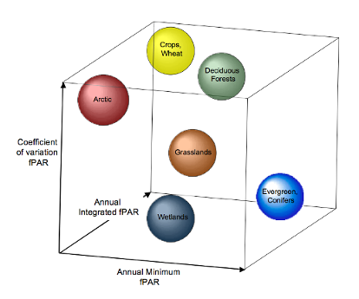
2010

Slide 21
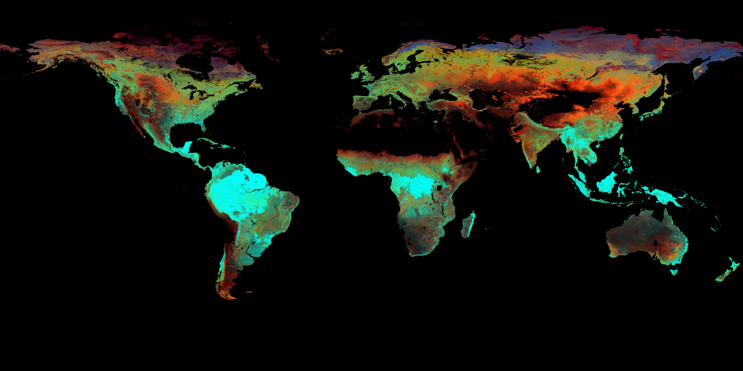
1981

Slide 22
1982

Slide 23
1983

Slide 24
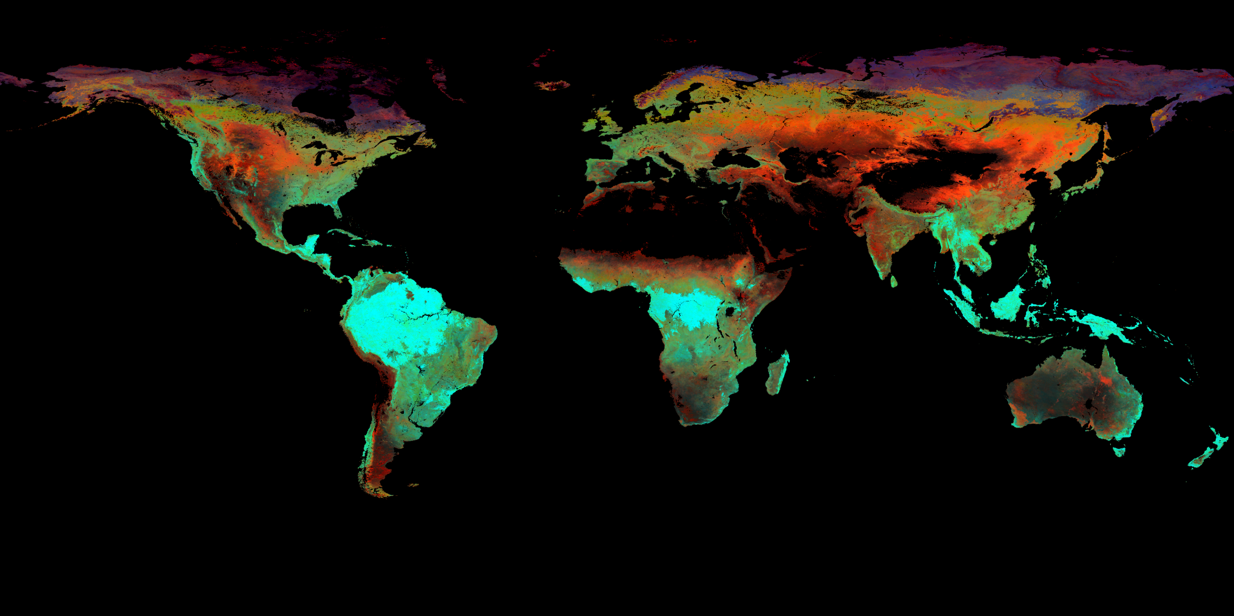
1984

Slide 25
1985

Slide 26
1986

Slide 27
1987

Slide 28
1988

Slide 29
1989

Slide 30
1990

Slide 31
1991

Slide 32
1992

Slide 33
1993

Slide 34
1994

Slide 35
1995

Slide 36
1996

Slide 37
1997

Slide 38
1998

Slide 39
1999

Slide 40
2000

Slide 41
2001

Slide 42
2002

Slide 43
2003

Slide 44
2004

Slide 45
2005

Slide 46
2006

Slide 47
2007

Slide 48
2008

Slide 49
2009

Slide 50
2010

Slide 51
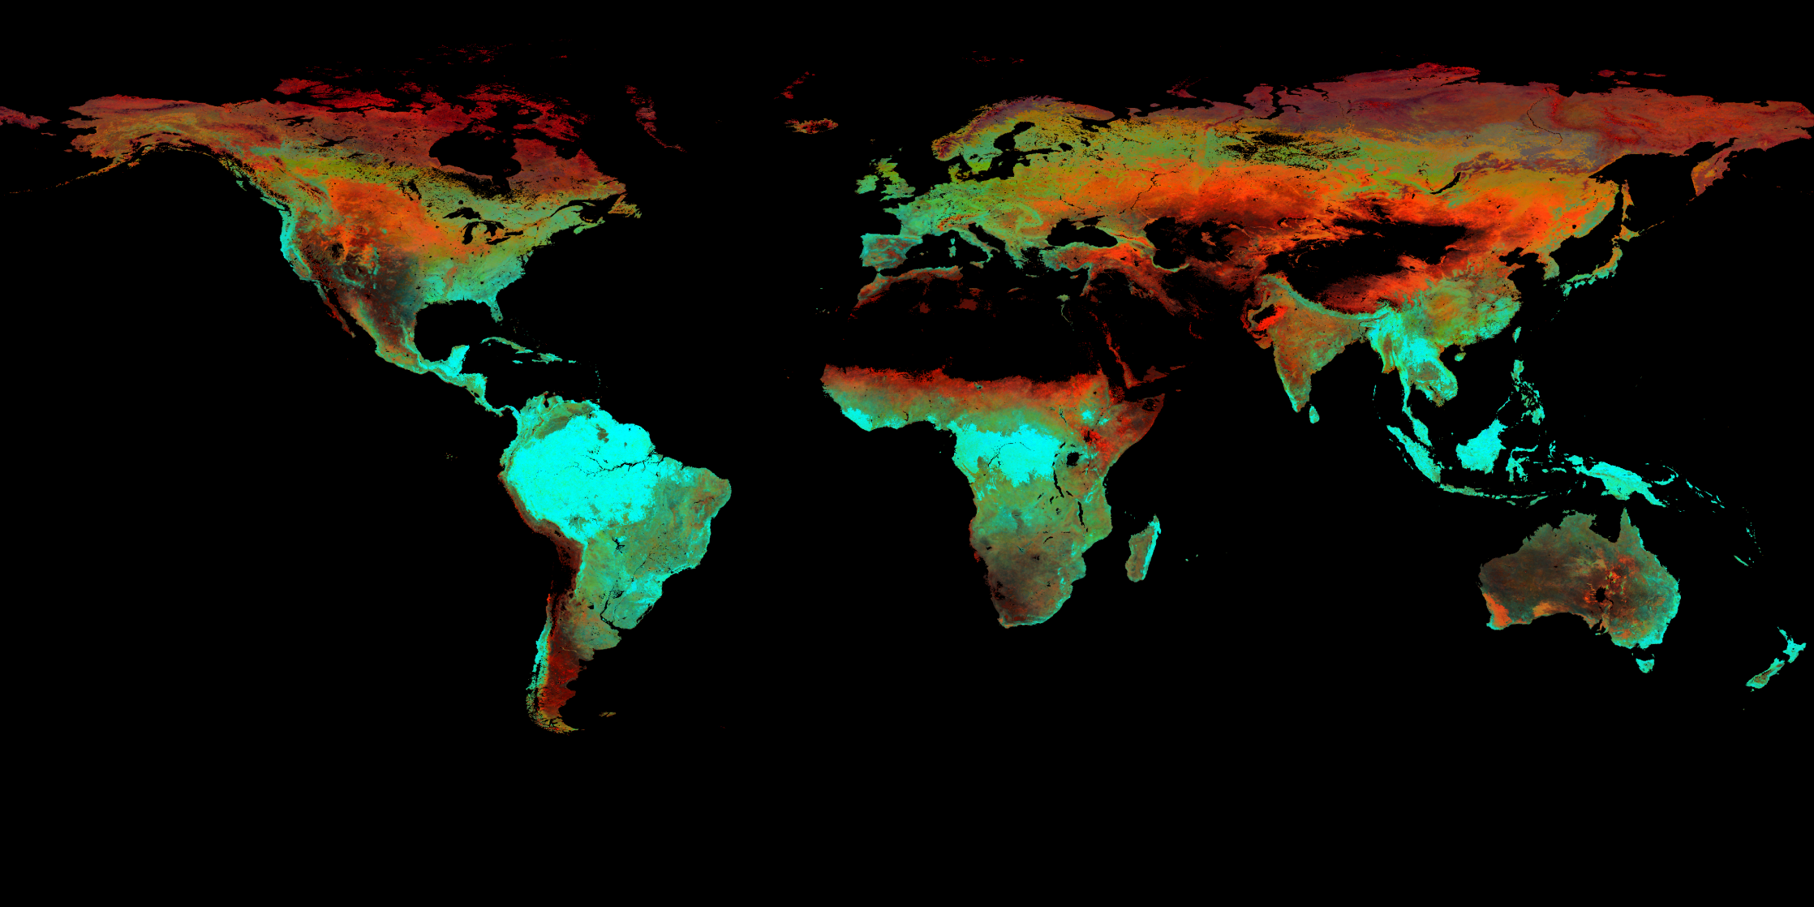
2011

Slide 52
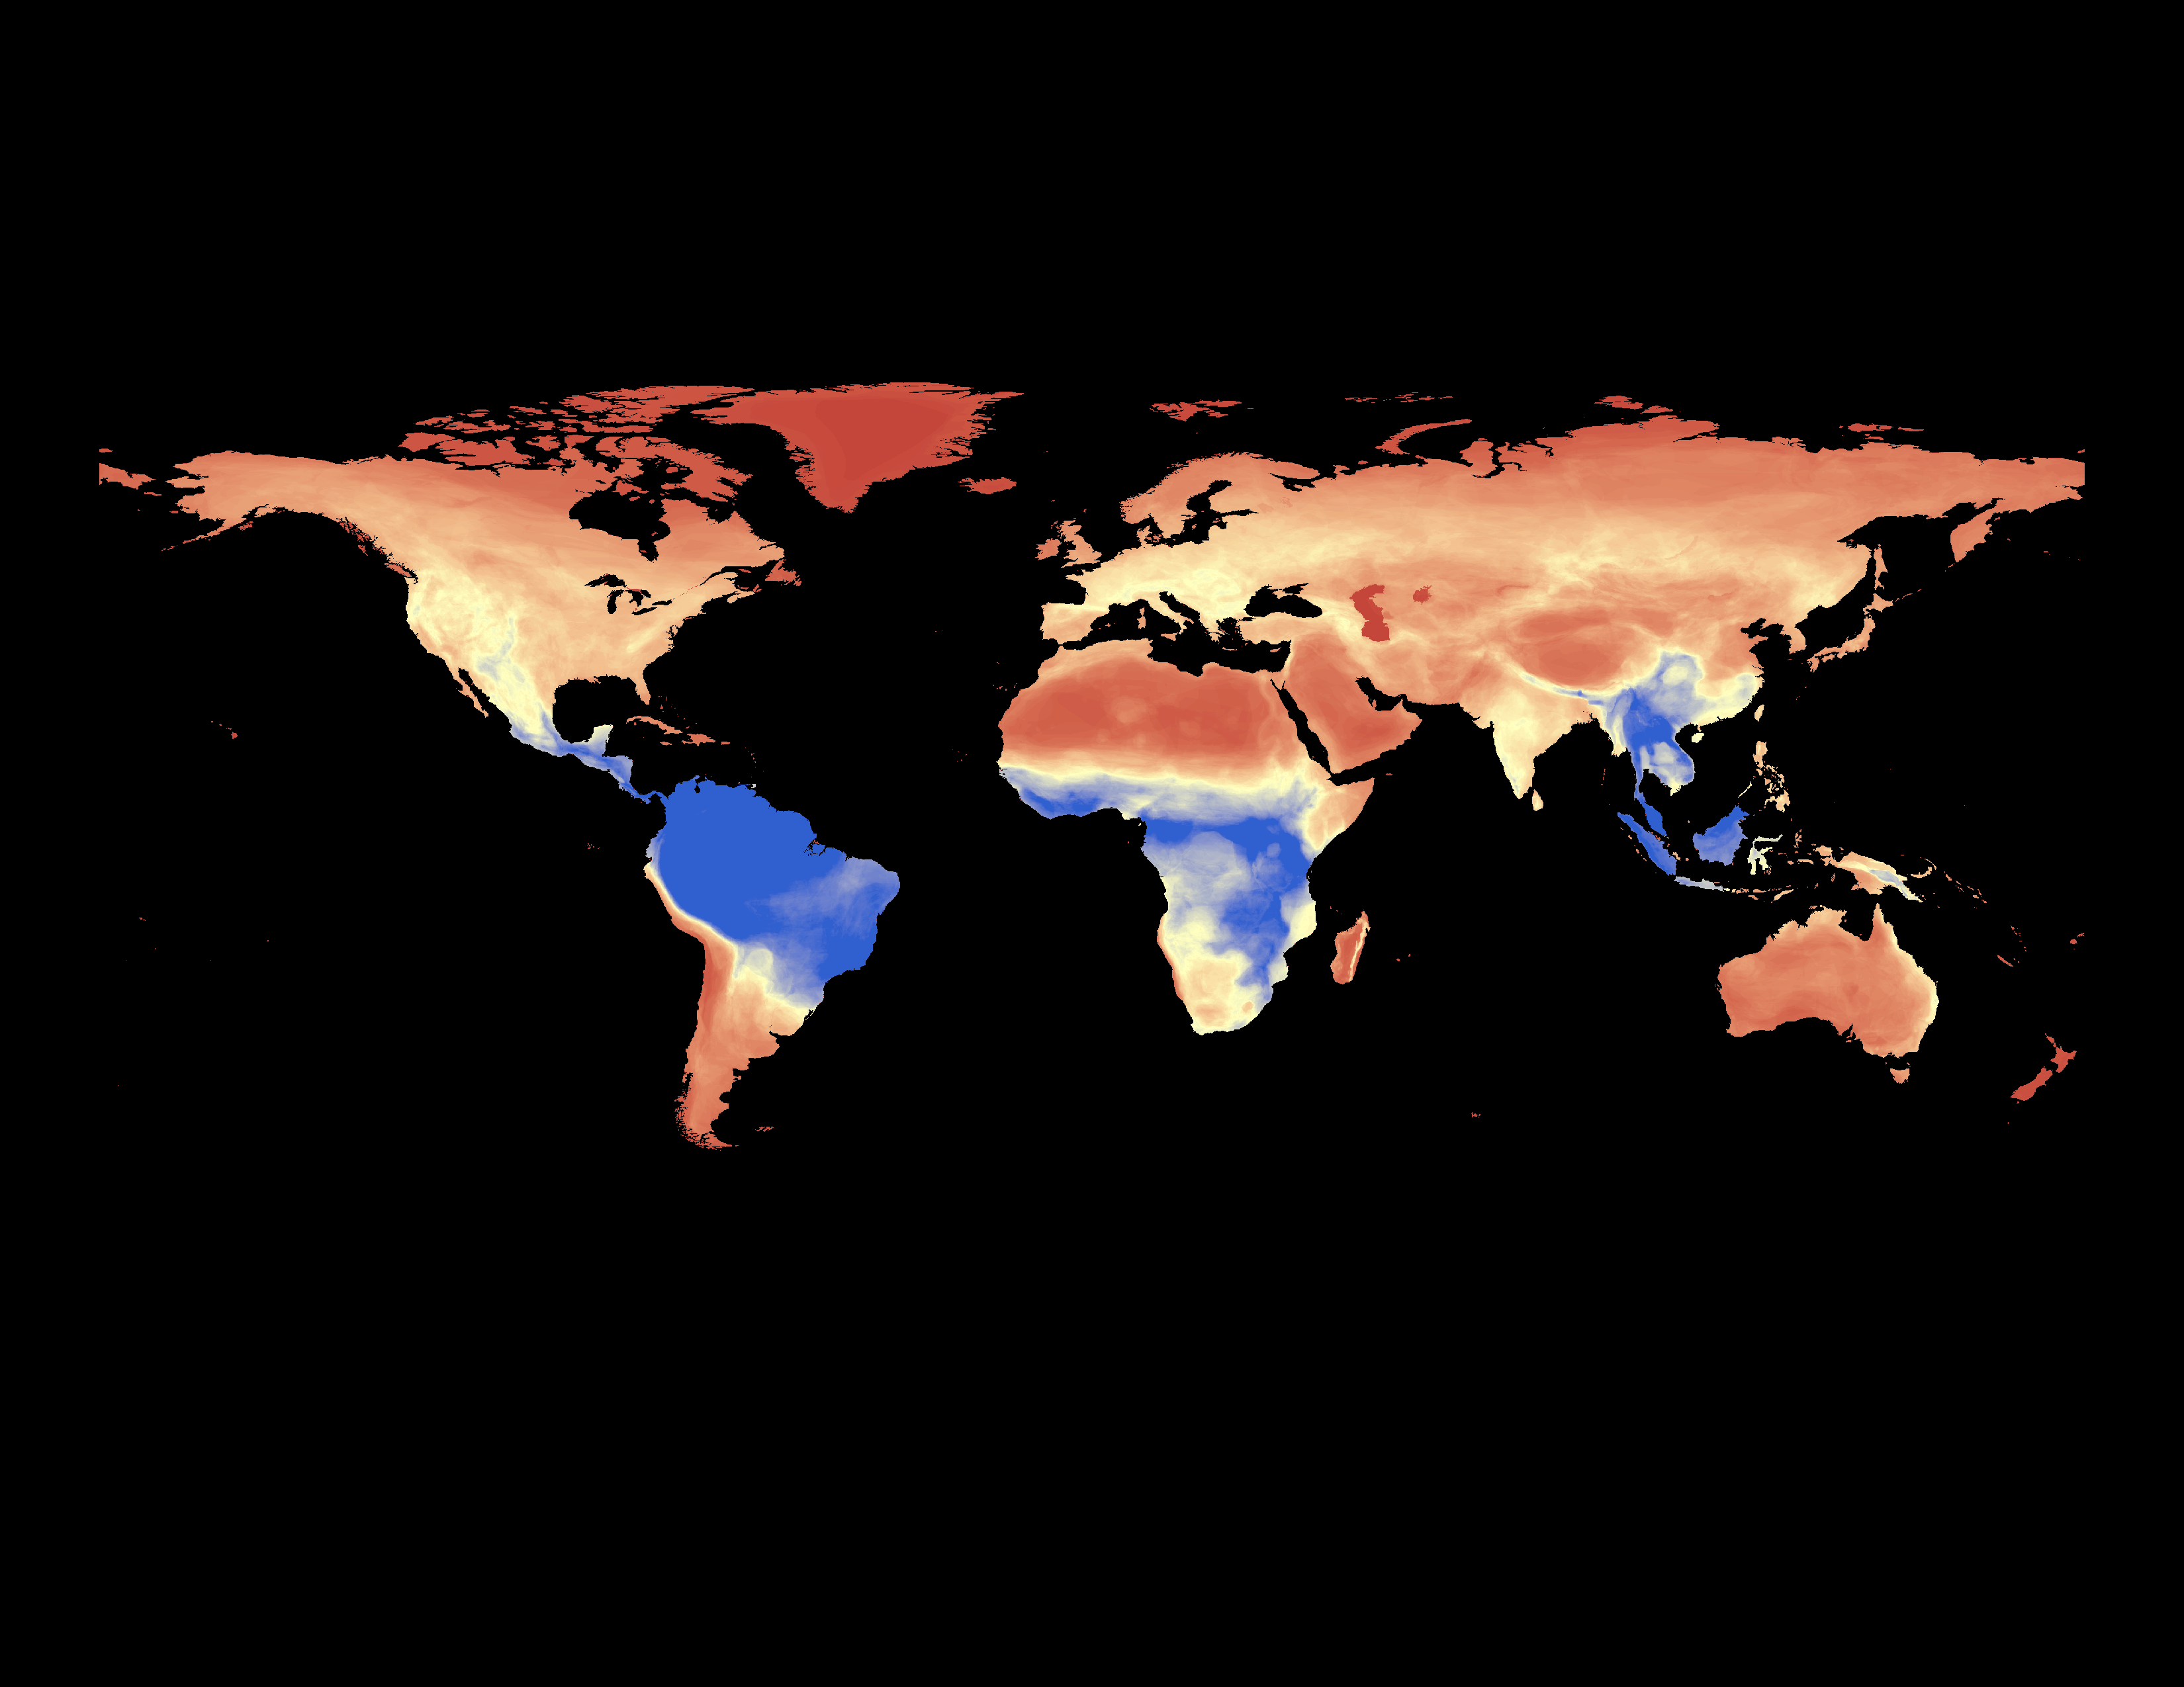
Mammals

Slide 53
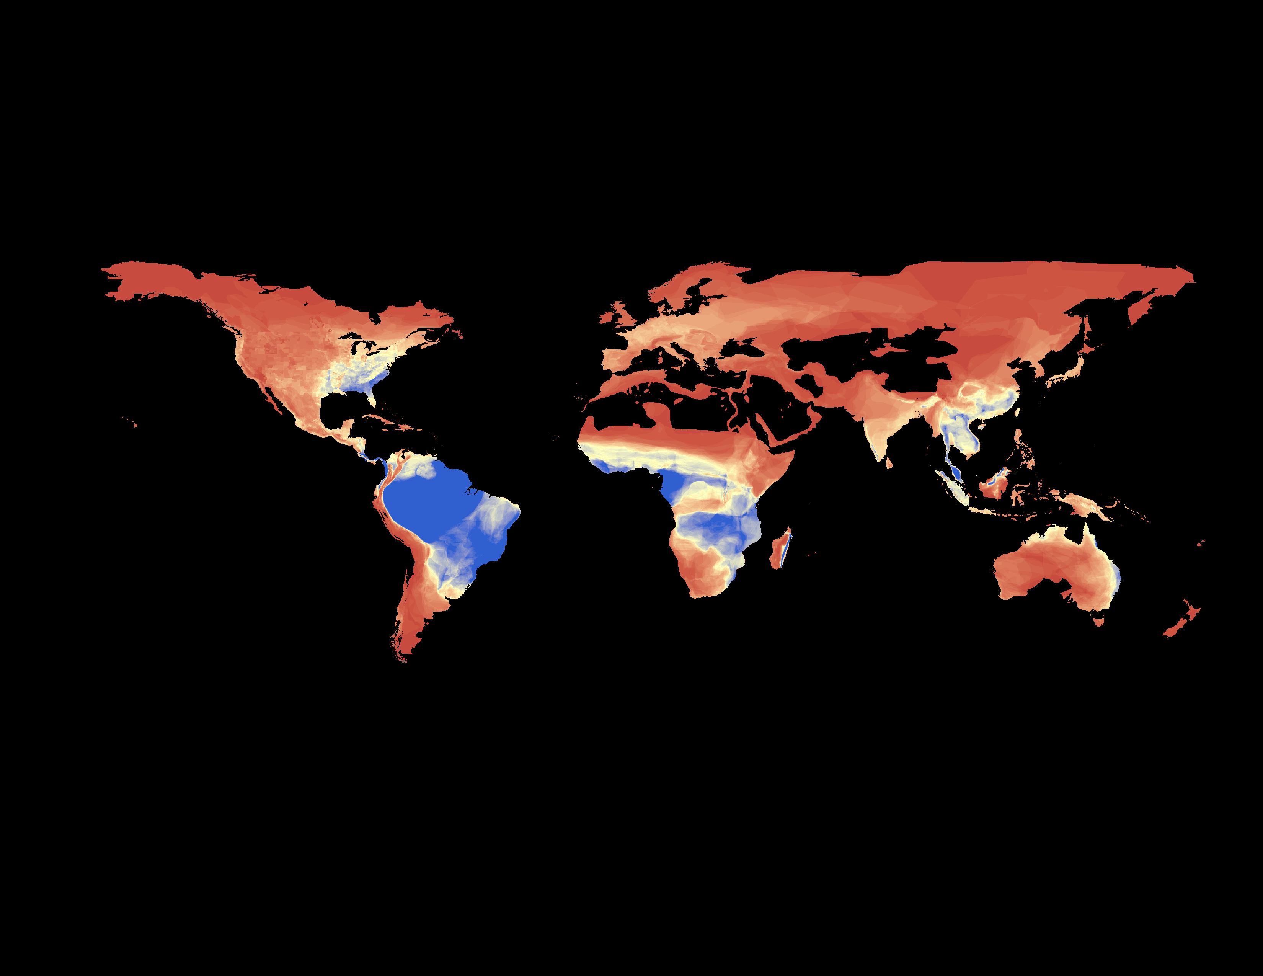
Amphibians

Slide 54
All Biomes
Pearson’s correlation coefficients (r)
 | Cumulative Productivity | Minimum Productivity | Seasonality
Amphibians | 0.68 | 0.69 | -0.51
Mammals | 0.70 | 0.67 | -0.46

Slide 55
DHI: Robustness
Change vegetation data input
NDVI, EVI, fPAR, LAI and GPP data; 1-km
Change spatial resolution
NDVI and EVI at 250, 500, and 1000-m

Slide 56
DHI: Robustness
Change vegetation data input
NDVI, EVI, fPAR, LAI and GPP data; 1-km
Change spatial resolution
NDVI and EVI at 250, 500, and 1000-m
Remove snow cover
Remove burned areas

Slide 57
DHI: Robustness
Change vegetation data input
NDVI, EVI, fPAR, LAI and GPP data; 1-km
Change spatial resolution
NDVI and EVI at 250, 500, and 1000-m
Remove snow cover
Remove burned areas
Compare DHI among land cover classes
Compare DHI among years

Slide 58
DHI: Predictive Power
DHI versus alpha-diversity
Global mammals, amphibians and birds from IUCN

Slide 59
DHI: Predictive Power
DHI versus alpha-diversity
Global mammals, amphibians and birds from IUCN
DHI versus beta-diversity
Global mammals from C. Graham

Slide 60
DHI: Predictive Power
DHI versus alpha-diversity
Global mammals, amphibians and birds from IUCN
DHI versus beta-diversity
Global mammals from C. Graham
DHI versus species occurrences
BBS and GBIF bird data

Slide 61
DHI: Predictive Power
DHI versus alpha-diversity
Global mammals, amphibians and birds from IUCN
DHI versus beta-diversity
Global mammals from C. Graham
DHI versus species occurrences
BBS and GBIF bird data
DHI versus large mammal abundances
Russian Winter Track Counts

Slide 62
DHI: Predictive Power
DHI versus alpha-diversity
Global mammals, amphibians and birds from IUCN
DHI versus beta-diversity
Global mammals from C. Graham
DHI versus species occurrences
BBS and GBIF bird data
DHI versus large mammal abundances
Russian Winter Track Counts
. . . !

Slide 64
Thank you!

Slide 67
